Slide 1
Importance of education
Saidurga Mallela​

Slide 2
AGENDA
What is Education
Purpose of Education
Importance of Education
​Present Education System
Education System in India
Possible Solutions
​

Slide 3





Education is the action or process of educating or of being educated.
Education is a purposeful activity aimed at achieving certain goals, which include the transmission of knowledge, skills, and character.
What is
Education ?

Slide 4
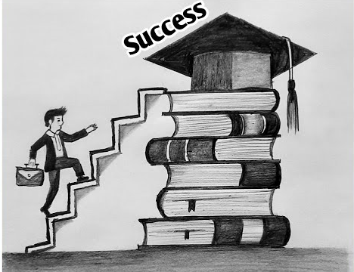
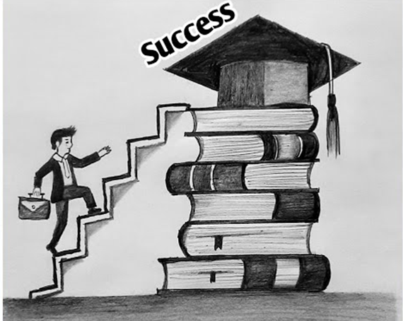
According to the U.S Department of Education, the purpose of education is: “to promote student achievement and preparation for global competitiveness by fostering educational excellence and ensuring equal access”.
The main purpose of education is the integral development of a person. In addition, it is a source of its obvious benefits for a fuller and better life. Education can contribute to the betterment of society as a whole. It develops a society in which people are aware of their rights and duties.
Purpose of
Education

Slide 5




Education helps you develop critical skills like decision-making, mental agility, problem-solving, and logical thinking.
Education plays an important role in the development of an individual, society and nation. Education is an asset for any country. Education helps in building responsible citizens of the country. Education enables us to fight injustice in society. Every individual has the right to get a good education and thus a proper education system is compulsory for any country. Education play important role in one's life. It affects our life from birth to death. So, there is a great need to be strong in our education system.
Importance of
Education

Slide 6

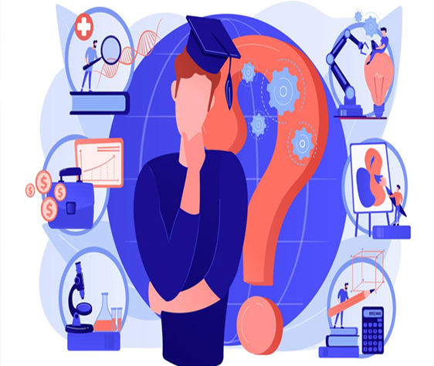
Realizing your true potential
Sharpening critical skills
More opportunities
Financial stability
Supporting a developed society
Giving back to the community
Blurring geographical boundaries
Equal opportunities
As a tool for empowerment
Importance of
Education

Slide 7

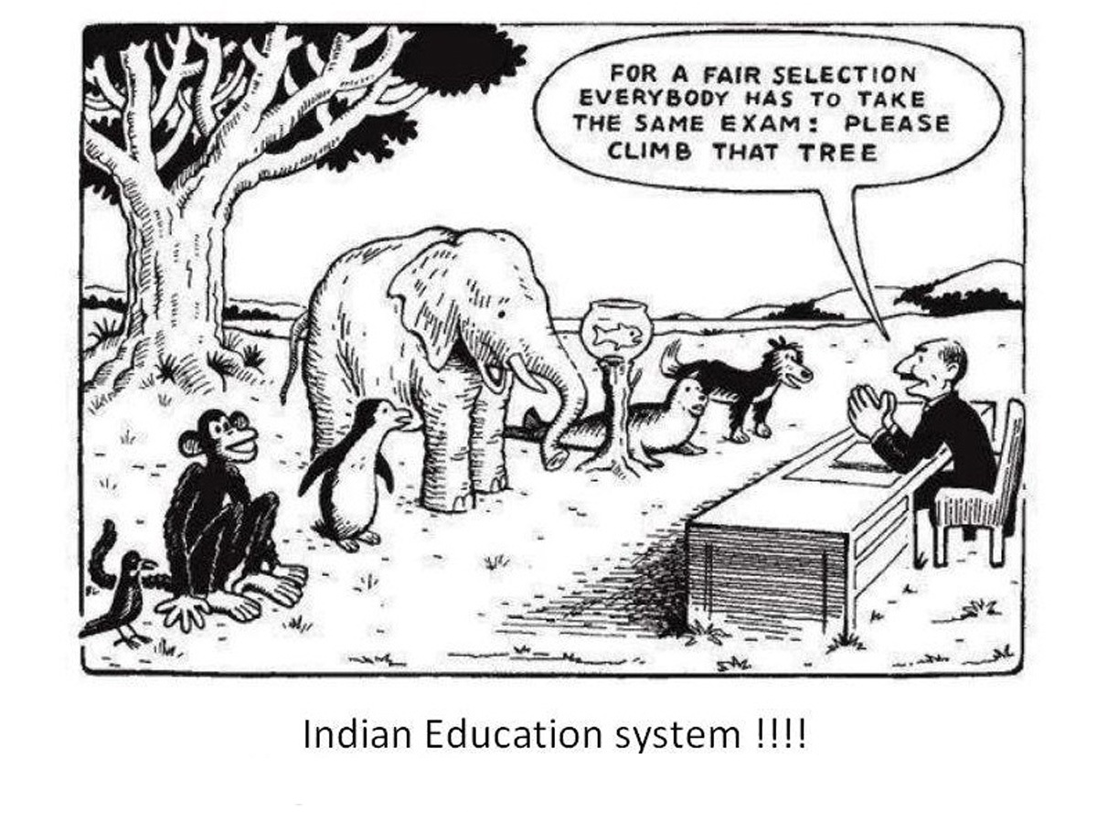
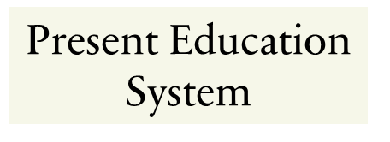

Education system judge students based on their academic performance and not on their overall performance. This affects those students who are not good at specific subjects. Bookish knowledge is the prime motto of the Indian education system. The focus is given on the theoretical knowledge only not on practical knowledge. As a result, most Indian student gets unemployed despite having high qualification.

Slide 8
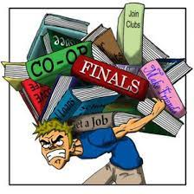

Lack of practical knowledge
No scope for other fields except studies
Wrong learning method
Lack of funds and quality teachers
No value to education
Problems of Primary Education
Wastage of resources
Drawbacks In
Education System

Slide 9
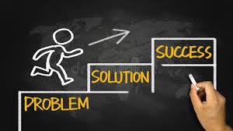
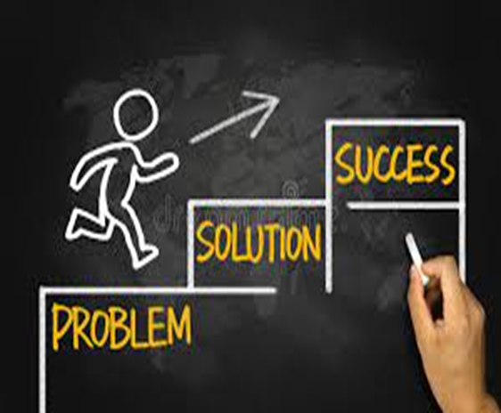
Innovative Teaching Methods
Subsidies and Grants for Professional Courses
Making Sports Compulsory
Educate Parents
Government Initiatives
Compulsory and free education for all
Quantity and quality of teachers
Zero tolerance against discrimination and harassment
Possible Solutions

Slide 10
“Education is the most important weapon with which you can change the world”
~Nelson Mandela
“Education is not the learning of facts, but the training of the mind to think”
~Albert Einstein
“Education is the key that unlocks the golden door to freedom.”
~George Washington

Slide 11
THANK YOU

